Slide 1
Introduction to
Unified Communication Manager Interfaces
Update Jan 2011

Slide 2
Agenda
Why Develop Unified Communication Manager Applications?
Provisioning Interfaces
  Administration XML
  Extension Mobility Service AP
Device Monitoring and Call Control Interfaces
  Cisco Routing Rules
  Cisco TAPI and Cisco Media Driver
  Cisco JTAPI
  Cisco WebDialer
Serviceability Interfaces
  Serviceability XML - PerfMon, Real-Time Device/CTI Feed,
  Log Collection, Service Control, Call Detail Records
  SNMP/MIBs

Slide 3
Why Unified CM Interfaces? Updated Dec 2010
Focus point of Cisco’s UC portfolio
>85% of Fortune 500 are using Cisco UC
100,000+ customers globally
34M+ Unified IP phones deployed world-wide
32.1% enterprise telephony market share
21M+ unified messaging seats
2M+ contact center seats
410K+ MeetingPlace licenses
66M+ VoIP gateway ports
Unified CM Is in the Middle of the (Inter)action!

Slide 4
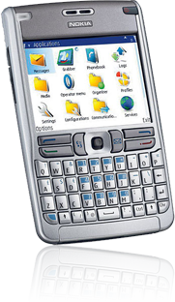



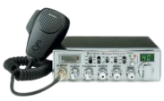


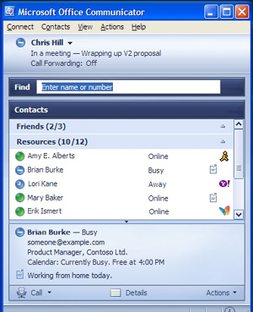


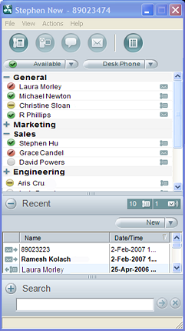
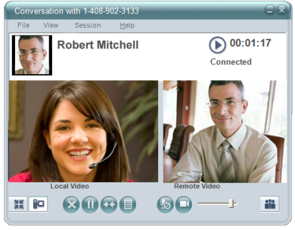
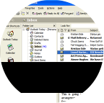

The Platform for Collaborative Communications
Interoperability and Collaboration System
Unified Mobile Communicator
WebEx and MeetingPlace
Collaboration
Sametime or Microsoft IM
Unified Personal Communicator
Unified CM
Unity
Telepresence

Slide 5
Unified CM Interface Types
Interaction framework - contain a greater number of Unified CM functions and events so the developer has more control over the interaction
  Administrative XML, CTI-TAPI, CTI-JTAPI
Macro APIs - provides the developer with quick easy methods to invoke Unified CM features while abstracting granular details
  Extension mobility API, WebDialer, Routing Rules API
Serviceability APIs - real-time information feeds that provide monitoring applications with system status and health data
  Serviceability XML, PerfMon, real-time device/CTI feed, log collection, service control, call detail records, SNMP/MIBs

Slide 6
Unified CM Interfaces
Standards-based (XML, HTTP, SOAP, MS TAPI 2.1, Sun JTAPI 1.2, SNMP v1 and v2)
Backward compatible
Easily consumable
Support for multiple IDEs, languages, and protocols
Part of the Cisco developer community
http://developer.cisco.com

Slide 7
Provisioning Interfaces
Administrative XML (AXL)

Slide 8
Administrative XML Interface (AXL)
Enables remote provisioning of Cisco Unified CM
Users, devices, lines, gateways, hunt groups,
trunks… literally everything is an object in the Unified CM database
XML, SOAP-based
Each object has attributes
AXL enables applications to create, read, update, and delete these objects

Slide 9
Ways to Use AXL
SOAP methods - fully backward compatible
  Add, Update, Delete, List
  User, device, line, hunt group, trunk, etc.
Direct SQL - compatibility based on schema changes
  ExecuteSQLupdate-DB changes via SQL
  ExecuteSQLquery-DB read/query via SQL

Slide 10
Administrative XML Sample Applications
Provisioning - remotely configure Unified CM
  Significantly reduce move, add, and change costs
  Target: large enterprise, service provider, multisite
  API: Administrative XML
Hospitality and healthcare - remotely prepare and reset guest and patient telephone services (personal reachability, speed dials, IP phone services/applications)
  Improves customer service
  Target: hotel and hospitality
  API: Administrative XML, Extension Mobility API

Slide 11
Administrative Sample Applications
Sales + Shift Worker Environments - Remotely Provision Phones
to Support Hot Desk Seating
Maximizes usable space
Offers Users a personalized telephony experience
Target: any free seating or hot desk environment - large and small enterprises
  API: Administrative XML, Extension Mobility API

Slide 12
Concepts -
XML, WSDL, SOAP

Slide 13
XML
eXtensible markup language
W3C recommendation
Restricted form of SGML
(Standard Generalized Markup Language, ISO 8879)
General purpose markup language
Extensible; individual tags can be defined
W3C specifies grammar and parsing requirements
Encode documents and serialize data
XML 1.0 (4th edition), 16 August 2006
http://www.w3.org/TR/2006/REC-xml-20060816/

Slide 14
XML, Well-Formed Document
Document conforms to all syntax rules
E.g., opening/closing tag for elements
Not validated against schema
Example:
  <person>
  <lastname>Krohn</lastname>
  <givenname>Johannes</givenname>
  </person>

Slide 15
XML, Special Characters
Some characters can´t be used in XML
Solution: escape or numerical representation
Escape:
  &amp; & ampersand
  &lt; < less than
  &gt; > greater than
  &apos; ’ apostrophe
  &quot; ” quotation mark
  example: <company>AT&amp;T<company>
Numerical representation of Unicode codepoint
  Example: ™= &#x2122

Slide 16
XML, Semantics
Names, hierarchy, meaning of elements and attributes defined by schema
XML schema defined by W3C
Primer: http://www.w3.org/TR/xmlschema-0/
Example:
  <xsd:element name="person" type="PersonType"/>
  <xsd:complexType name="PersonType">
  <xsd:sequence>
  <xsd:element name="lastname" type="xsd:string"/>
  <xsd:element name="givenname" type="xsd:string"/>
  </xsd:sequence>
  </xsd:complexType>

Slide 17
SOAP
Formerly known as Simple Object Access Protocol
W3C specification: http://www.w3.org/TR/soap/
Exchange of structured and typed information based on XML; XML infoset
SOAP spec. defines
  SOAP message format
  How to send and receive messages
  Data encoding
Can be used for remote procedure calls (RPC)

Slide 18
SOAP Message
SOAP Message
Envelope
Header (optional)
Body (required)
Fault (optional)

Slide 19
RPC Requirements
RPC requires:
  Address of SOAP node
  Procedure/method name
  Identities/values of arguments
  Output parameters, return values
Interface/service definition not part of SOAP

Slide 20
Web Services Definition Language (WSDL)
W3C: http://www.w3.org/TR/wsdl20/
XML-based format (grammar) to describe web services
Defines four pieces of data:
  Publicly available methods; interface description, formats
  Data type information for requests and responses
  Binding; which transport protocol
  Address information; where to find the service

Slide 21
WSDL Service Description Elements
Definitions: Root Element
Types: Which Datatypes Are Exchanged?
Message: Which Messages Are Exchanged?
portType: What Operations/Functions Exist?
Binding: Message Exchange; SOAP Specifics
Service: Location of the Service

Slide 22


WSDL Operation Patterns
One-Way
Client
<input>
Service
Notification
Client
<output>
Service
Solicit/Response
<output>
Client
Service
<input>
Request/Response (Used By AXL)
<input>
Service
Client
<output>

Slide 23
Administrative XML Configuration API
Read/modify configuration database
Methods
  list*
  add*
  update*
  get*
  remove*
Includes methods for direct database access
Service port: https://<server>:8443/axl/

Slide 24
Administrative XML Versioning
Abstracts developer from DB schema changes
  API methods only, direct SQL does not offer
  backward compatibility
Maintains R-2 backward compatibility
  Developers writing to Unified CM 8.0(1) will not have to make changes until 10.1(1)
  Oldest schema is always the default
Developer specifies desired schema version via the SOAPAction header
  E.g., SOAPAction: CUCM:DB ver=8.0
SOAPAction header is mandatory

Slide 25
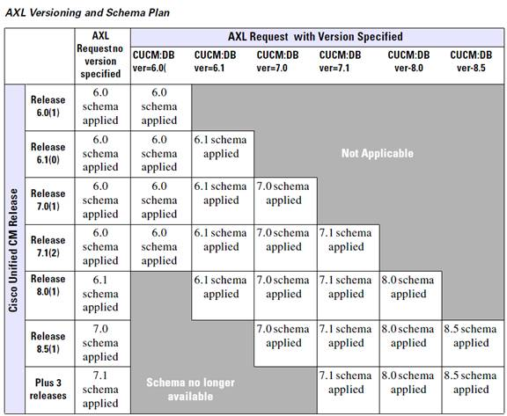
Versioning for AXL Methods
Provides Up to Two Years of Backward Compatibility

Slide 26
Performance
Dynamic throttling-introduced in UCM 6.1(3)
  Single request limited to <8MB data
  Concurrent request limited to <16MB
Up to 1500 writes per minute
Intelligently accepts or rejects requests
  Row fetch returned when data limits are exceeded
Always enabled

Slide 27
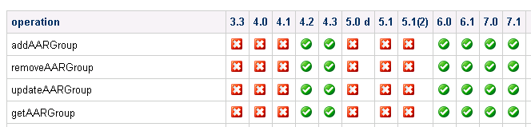
API Planning-Methods by Release
Located in appendix sections of all developer guides
Identifies methods supported or modified by release
Administrative SOAP API Details
Provided by AXLAPI.wsdl.
N : supported, n : not supported, : modified
Sorted by operation while ignoring prefixes of add, remove, update, get, list

Slide 28
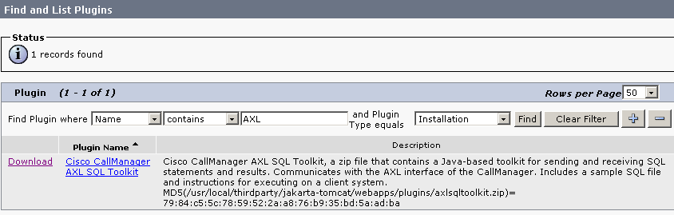
AXL Documentation on the Server
Cisco Unified CM AXL SQL toolkit is available in the
plug-in list
Contains complete schema definition:
  AXLAPI.wsdl, AXLEnums.xsd, axlmessage.xsd, axlsoap.xsd, axl.xsd

Slide 29
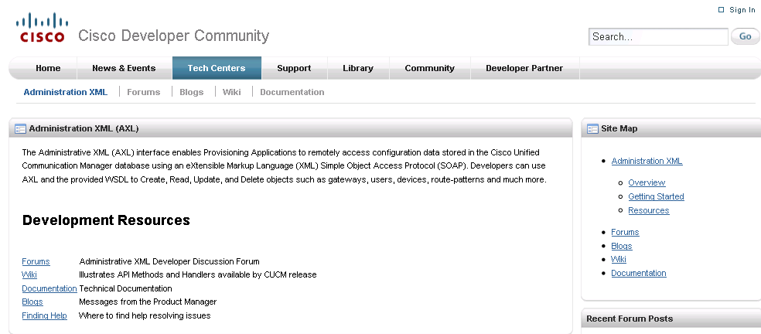
Getting Started
http://developer.cisco.com/web/axl/start
Documentation, NFR software, hardware, devices, tool kits, sample applications, interface specs

Slide 30
Macro Interface -
Extension Mobility API (EMAPI)

Slide 31

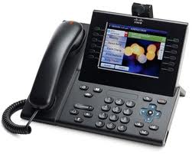


What Is Extension Mobility?
An XML/HTTP-based Unified CM service that dynamically associates device settings and preferences such as call forward, ring tones, speed dials, and IP phone applications to a User
Enables free seating, hot desking environments
Login
IP Phone
Logout
Unified CM
User A
DN: 90001
0 and 911 Access
User: John Bloggs
DN: (352)555-3344
Int’l Access
User:
John Bloggs

Slide 32


What Is the Extension Mobility API
An XML-based HTTP interface that allows applications to remotely invoke the extension mobility feature on behalf of a User
Guest Checks Into Hotel
App Server Provisions Room Phone
Check In
Check Out
Unified CM
IP Phone
User: Room 901
DN: 90001
0 and 911 Access
User: Luis Gomez
DN: (352)555-3344
Premier Guest
Language Set
to Spanish

Slide 33
Points to Know
Extension Mobility (EM) API provides interface for programmers / third-party applications to perform
login and logout operations
The EM service processes the API requests
The EM service can be loaded by the Tomcat web server in any Unified CM by activating the Cisco Extension Mobility service
Programmers can make use of this service, by sending XML requests (EM API) over HTTP
Since the EM service is a Java-based application, these API requests are platform-independent

Slide 34
EM API Architecture
XML Request
XML Response
HTTP Post
HTTP Response
JSP
Tomcat Server
EMService Servlet
EMService Java Object
SAX Parser
Authentication
Logout
Scheduler
Policy Validation
DB Request
DBL
JNI
Logout Service Request

Slide 35
EM API Process
EM service parses the XML request from application
Authenticates the User with either database or directory
Checks the policy to ensure the User is allowed to login or logout
Invokes a database request to perform either login or logout for the User
If auto-logout is configured, then it schedules a logout task which will happen after the specified duration

Slide 36
Methods Available
Login - associates User with device
Logout - removes User from device
Logout All – removes all Users from devices
  Useful when performing system upgrades
User Query - returns name of device(s) where a User is logged in
Device Query - returns the User ID(s) who are logged into a device
Device Profile Query - returns the device profile(s) associated with a User ID

Slide 37
Sample Code
Login Request
<request>
  <appInfo>
    <appID>7975LoginApp</appID>
    <appCertificate>password</appCertificate>
  </appInfo>
  <login>
    <deviceName>SEP003094C25B15</deviceName>
    <userID>rknotts</userID>
  </login>
</request>

Slide 38
Sample Code
Logout Request
<request>
  <appInfo>
    <appID>7975LoginApp</appID>
    <appCertificate>password</appCertificate>
  </appInfo>
  <logout>
    <deviceName>SEP003094C25B15</deviceName>
  </logout>
</request>

Slide 39
Performance
Logins are sequential
Login rates-based on Unified CM 7.0(1) testing
  Cisco MCS-7845-250 login/logout/min-(14880 per hour)
  Cisco MCS-7835-235 login/logout/min
  Cisco MCS-7825-200 login/logout/min
EM can be enabled on multiple subscribers for redundancy and added performance
  Maximum cluster login/logout limit is 375 per min regardless of number of subscribers enabled for EM
Throttle setting protects CPU resources by limiting login/logout rate per minute
EM returns system busy, please try later when throttle
is exceeded

Slide 40
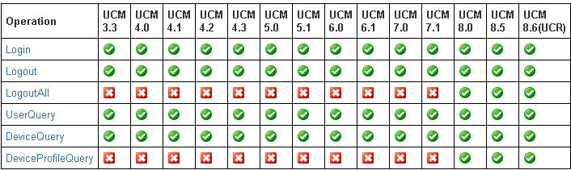
API Planning –
Extension Mobility Operations by Release
Located in appendix sections of all developer guides
Identifies methods supported or modified by release
Table Legend
N : supported, n : not supported, : modified

Slide 41
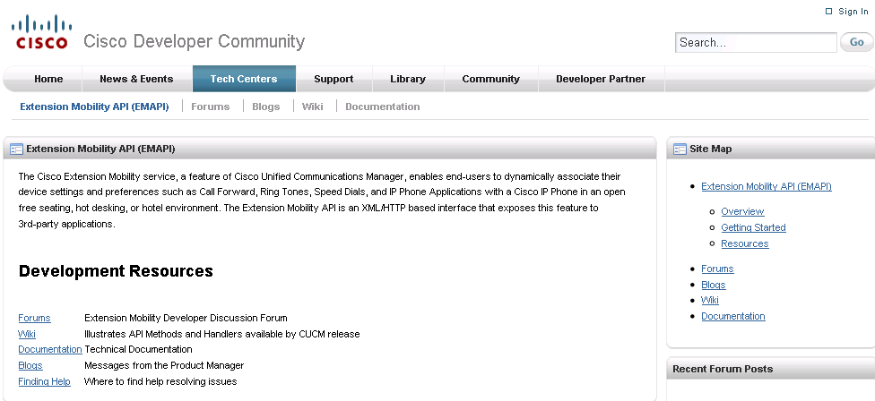
Getting Started
http://developer.cisco.com/web/emapi/start
Documentation, NFR software, hardware, devices, tool kits, sample applications, interface specs
Extension mobility API information is found in chapter three of the Cisco Unified Communication Manager XML Developer’s Guide

Slide 42
Call Control and Device Monitoring Interfaces

Slide 43
Cisco TAPI-Telephone Service Provider
Provides First-Party Call Control (1PCC)
  Perfect fit for desktop soft phones and server-based IVR applications answering calls
Provides Third-Party Call Control (3PCC)
  Perfect fit for server or desktop applications that perform screen pops for incoming calls and click-to-connect from Windows applications
Provides ability to interact with media layer
  Allows applications to terminate media, play announcements,
  record calls
  Cisco TAPI provides a media driver that allows 1PCC applications to easily interact with call audio using standard Windows sound APIs
Programming in C and C++
Conforms to Microsoft TAPI 2.1 standard

Slide 44
Cisco JTAPI
Provides First-Party Call Control (1PCC)
  Perfect fit for desktop soft phones and server-based IVR applications answering calls
Provides Third-Party Call Control (3PCC)
  Perfect fit for server or desktop applications that perform screen pops for incoming calls and click-to-connect from Windows or Linux applications
Provides all the hooks necessary to integrate with
standard or custom RTP libraries (for example: Java
Media Framework), but does not provide a specific
audio implementation
Conforms to Sun JTAPI 1.2 standard

Slide 45
Cisco Unified Routing Rules Interface (CURRI)
Enables web-service applications to remotely Permit, Deny, or Redirect calls based on regulatory rules and business logic
  Perfect for Allowed/Blocked calling list applications, Best Voice Quality routing, Least-Cost routing, and routing based on
  Time-of-day, Day-of-week, and Presence/Availability
Supports in- and outbound calls
Uses XACML* over HTTP or HTTPS
  eXtensible Access Control Markup Language, an OASIS standard
  Standards-based XML-based language

Slide 46
TAPI, JTAPI, and Routing Rules Applications in the Enterprise
Presence-based routing - combine User availability, location, and preferences to render a uniquely tailored UC experience
  E.g., single number reach-find me, follow me, hide me
Financial specialist soft phone - combine market data, business logic, and call control in a browser-based application to enable brokers and analysts to respond to rapid changes in today’s global financial markets
Healthcare consoles - combine call control, doctor/patient lookup, and emergency response team paging into a browser-based console

Slide 47
TAPI, JTAPI, and Routing Rules Applications in the Enterprise
Ethical Wall – Allow, Deny, or Redirect calls based on Calling/Called Party. Play custom announcements.
Hospitality - link caller data with POS systems to automate room or restaurant reservations, dispatch taxis, schedule wake-up calls, and more
Self-service - collect caller information to provide automated services across a variety of devices

Slide 48
TAPI, JTAPI, and Routing Rules Applications in the Contact Center
Intelligent contact routing - application monitors the status of devices and issues routing instructions to send calls to the right place at the right time
  Call intercept, virtual hold
Call recording and analytics - application monitors the status of devices and issues start/stop recording instructions while retrieving call statistics for analysis
Desktop productivity - screen pop calls into CRM applications, automated scripting, and remote call control

Slide 49
Cisco TAPI and Media Driver

Slide 50
Cisco TSP Components
CiscoTsp001.tsp – Instance name for TAPI service implementation provided by Cisco TSP
  Up to 10 instances are supported per client
CTIQBE over TCP/IP - Cisco protocol used to monitor and control devices and lines
CTI Manager Service - Manages CTI resources and connections to Cisco IP Devices. Exposes call and device events to third-party applications via Cisco TSP (e.g. CiscoTsp001.tsp)

Slide 51
TAPI/TSP Architecture
Telephony Application Server/PC
Unified CM Server
TAPIApp.exe
TAPI
Tapi32.dll
Tapi64.dll
CTI Manager Service
TAPISRV.EXE
Private RPC Interface
CTIQBE over TCP/IP
TSPI
CiscoTsp001.tsp
Stations
RTP Packet Bus
Skinny Station Protocol (TCP)
SIP Line Protocol (TCP)

Slide 52
Basic Telephony APIs Supported
lineAccept - accepts the specified offered call
lineAnswer - answers the specified offering call
lineSetupConference - sets up a conference call for the addition of the third party
linePrepareAddToConference - prepares an existing conference call for the addition of another party
lineAddToConference - adds the call specified by hConsultCall to the conference call

Slide 53
Basic Telephony APIs Supported
lineSetupTransfer - initiates a transfer and creates a consultation call
lineCompleteTransfer - completes the transfer of the specified call to the party connected in the consultation call
lineBlindTransfer - performs a blind or single-step transfer of the specified call to the specified destination address
lineHold - places the specified call on hold
lineUnhold - retrieves the specified held call

Slide 54
How to Write a TAPI Application
Microsoft has defined some basic APIs which can be invoked/supported from application code
All Microsoft-defined APIs that can be used from the TAPI applications are declared in TAPI.H file
TAPI.H file is a standard library file included with the VC++/VS2010 installation.
To use any specific API which is added/provided by CiscoTSP, application needs to invoke that API by
using LineDevSpecific API

Slide 55
Simple TAPI Application
#include <tapi.h>
#include <string>
#include "StdAfx.h“
class TapiLineApp {
LINEINITIALIZEEXPARAMS mLineInitializeExParams;//was declared in TAPI.h files
HLINEAPP mhLineApp;
DWORD mdwNumDevs;
DWORD dwAPIVersion = 0x20005
public:
// App Initialization
// Note hInstance can be NULL
// appstr – value can be given the app name “test program”
bool TapiLineApp::LineInitializeEx(HINSTANCE hInstance, std::string appStr)
{
unsigned long lReturn = 0;
mLineInitializeExParams.dwTotalSize = sizeof(mLineInitializeExParams);
mLineInitializeExParams.dwOptions = LINEINITIALIZEEXOPTION_USEEVENT;
lReturn = lineInitializeEx (&mhLineApp, hInstance, NULL, appStr.c_str), &mdwNumDevs,&dwAPIVersion,&LineInitializeExParams);
if ( lReturn == 0 ) {
return true;
}
else {
return false;
}
}
//App shutdown
bool TapiLineApp::LineShutdown()
{
return ! (lineShutdown (mhLineApp));
}
};

Slide 56
A TAPI Application-TAPI Browser
TAPI browser is a TAPI debugging application
TAPI browser can be obtained from the Microsoft MSDN website (ftp://ftp.microsoft.com/developr/TAPI/tb20.zip)
TAPI browser can be used to initialize TAPI, for use by TAPI developers to test their TAPI implementation and to verify that the TSP is operational

Slide 57
Basic Call Using TAPI Browser
A Calls B
A | B
lineInitialize
openAllLines or openLine
(Select a Line Which Is Opened )
lineMakeCall (lpszDestAddress-Parameter Should Be Specified with Destination DN of Phone B)
 | lineAccept
 | lineAnswer
(Connected) | (Connected)

Slide 58
Cisco Media Driver
Cisco TSP includes a Media Driver which can be used to play or record media
Cisco RTP Object Library Components
  Set of C-language based Media APIs
  Codecs supported: G.711u-law, G.711a-law, G.729a
Improved resiliency
  User-Mode driver
  Runs in separate application memory space
Included by default during TSP client installation

Slide 59
Cisco Media Driver Architecture
32 bit/64 bit TAPI Application
TAPI
Cisco Media API
MSFT Telephony Service
Cisco Media Driver
Cisco TSP
32bit/64bit
G711
G729
RTP Library
APIs
CTI QBE
RTP /sRTP
RTP /sRTP
CTI Ports
RoutePoints
Cisco UCM

Slide 60
TSP Client Features
Rapid deployment and configuration – Supports Desktop & Silent/Remote Installation
Auto-upgrade – Keeps client version up to date with Unified CM server version
Cisco Media Driver – Provides media interaction (Play, Record)
TSP Notifier – Provides connection monitoring and error reporting

Slide 61
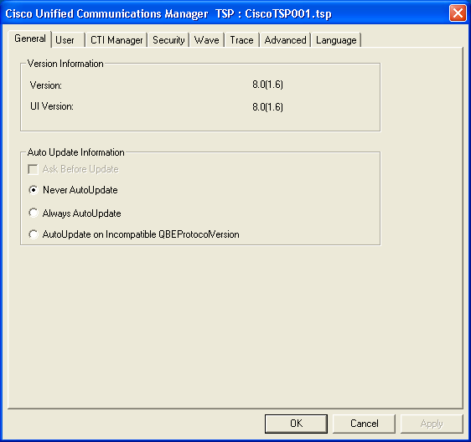
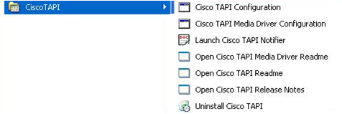
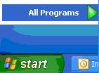
Configure Cisco TSP
StartgAll ProgramsgCisco TAPI Configurationg

Slide 62
Trace Settings and Troubleshooting
After installation of CiscoTSP.exe, trace settings can be configured by the following process
Go to Start->All Programs->Cisco TAPI Configuration
Select CiscoTSP0XX and click configure
Go to trace tab. Select trace on check box and select the following
TSP trace to trace the TSP internal messages
  Error - to just log errors in the TSP
  Detailed - to log internal messages for debugging purpose
CTI trace to trace the messages sent between CTI and TSP
TSPI trace to trace the requests and events sent between TSP
and TAPI

Slide 63
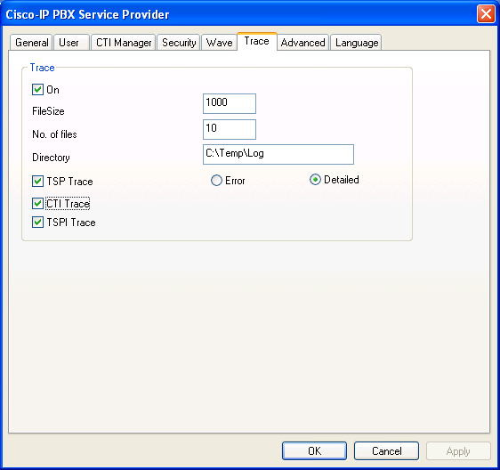
Trace Settings and Troubleshooting

Slide 64
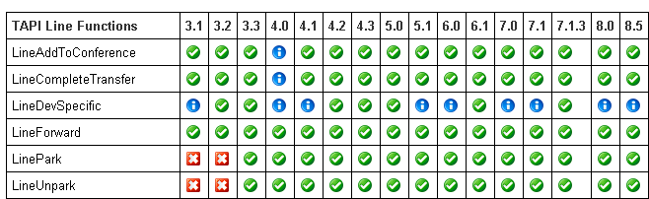
API Planning – Operations by Release
Located in appendix sections of all developer guides
Identifies Features, Line Functions, Line Messages, and Line Structures supported by release
Table Legend
N : supported, n : not supported, : modified
Example (below)

Slide 65
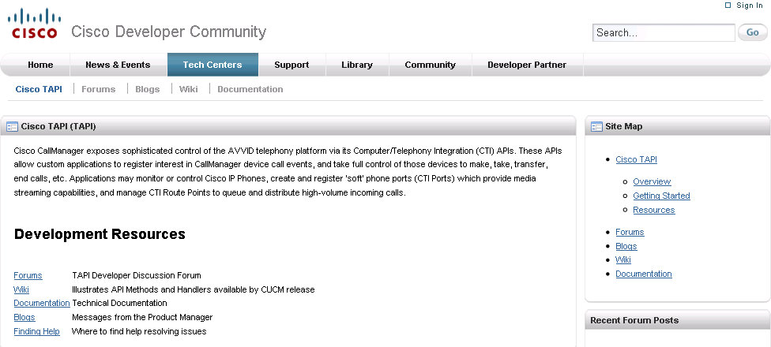
Getting Started
http://developer.cisco.com/web/tapi/start
TAPI/TSP Developer Guide
  Includes list of CTI supported devices and wave driver

Slide 66
Cisco JTAPI

Slide 67
Cisco JTAPI Overview
What Is Cisco JTAPI?
JTAPI is a programming interface standard developed by Sun Microsystems for use with Java-based computer-telephony applications
Cisco JTAPI implements Sun’s JTAPI 1.2 specification, with additional Cisco-specific extensions
Used to develop applications capable of controlling and observing Cisco Unified CM phones or applications capable of call routing with CTI ports and route points (virtual devices)

Slide 68
Cisco JTAPI Overview
Call Model
Provider
Call
Connection
Connection
Address
1002
Address
1000
Terminal
Connection
Terminal
Connection
Terminal
Connection
Terminal
SEPGHI
Terminal
SEPABC
Terminal
SEPDEF

Slide 69
Cisco JTAPI Overview
JTAPI Application Flow
Obtain JTAPIPeer object instance from JTAPIPeerFactory
Obtain a provider, using the getProvider() API on JTAPIPeer
Obtain from the provider, the terminal and address for use in
your application
Determine capabilities of relevant objects
Add observers for the objects, application wishes to monitor/control
Begin application flow( for e.g., begin calls)

Slide 70
Simple JTAPI Application
public void getProvider () {
try {
JtapiPeer peer = JtapiPeerFactory.getJtapiPeer ( null );
System.out.println ("Got peer "+peer);
Provider provider = peer.getProvider(“cti-server;login=username;passwd=pass");
System.out.println ("Got provider "+provider);
MyProviderObserver providerObserver = new MyProviderObserver ();
provider.addObserver(providerObserver);
while (outOfService ) {
Thread.sleep(500);
}
System.out.println ("Provider is now in service");
Address[] addresses = provider.getAddresses();
System.out.println ("Found "+ addresses.length +" addresses");
for(int i=0; i< addresses.length; i++){
System.out.println(addresses[i]);
}
provider.shutdown();
} catch (Exception e){
}
}

Slide 71
Basic Telephony APIs Supported
connect() - API on CiscoCall to place a call from originating endpoint to a destination address string
answer() - API on TerminalConnection to answer the incoming call on this TerminalConnection
redirect() - API on CiscoConnection to redirect an incoming telephone call at an Address to another telephone address
transfer(call otherCall) - API on CiscoCall which takes otherCall, which could be either consult call or just another call on same device, as input to complete transfer
transfer(string destination) - API on CiscoCall to complete
a blind transfer to destination

Slide 72
Basic Telephony APIs Supported
Conference (Call otherCall) - API on CiscoCall which takes otherCall, which could be either consult call or just another call on same device, as input to join together in single conference
Conference(Call otherCalls) - API on CiscoCall which takes list of otherCalls and join them together in single conference call
Hold() - API on TerminalConnection which allows application to put the call on hold

Slide 73
Cisco JTAPI Sample Applications
JTrace and MakeCall Sample apps
JTrace-displays events delivered to applications, for address DN1 and DN2
Usage: java jtrace.JTrace <IPAddress> <userid> <password> <DN1> <DN2>
MakeCall-to make call between two devices with an action delay of 1000 msecs until terminated
Usage: java makecall <server name> <login> <password> 1000 <DN1> <DN2>

Slide 74
Trace Settings and Troubleshooting
JTAPI Preferences
The JTPrefs application allows you to enable or disable various kinds of tracing
To turn on JTAPI traces run JTPrefs, and in JTAPI Tracing tab, select all the trace levels
Trace levels defined are:
  WARNING-warning events
  INFORMATIONAL-status events
  DEBUG-debugging events

Slide 75
Trace Settings and Troubleshooting
JTAPI Preferences
If DEBUG is enabled, JTPREFS allows you to enable/disable various debugging levels
JTAPI_DEBUGGING-to trace JTAPI methods and events
JTAPI_IMPLDEBUGGING-internal JTAPI implementation trace
CTI_DEBUGGING-to trace Unified CM events sent to
JTAPI implementation
CTIIMPL_DEBUGGING-internal CTICLIENT
implementation trace
PROTOCOL_DEBUGGING-full CTI protocol decoding
MISC_DEBUGGING-miscellaneous low-level debug trace

Slide 76
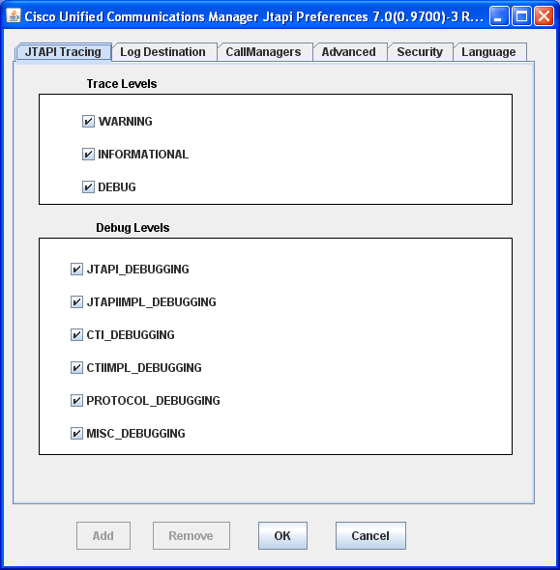
Trace Settings and Troubleshooting

Slide 77
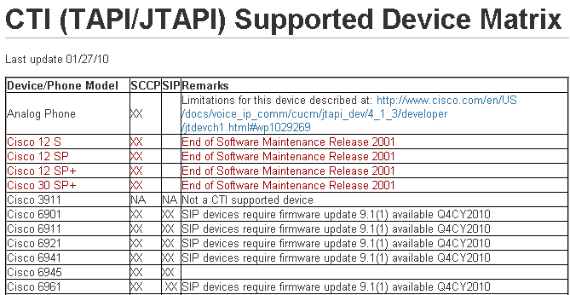
API Planning – CTI Supported Devices
Identifies Cisco IP Device models supported by CTI, including any required firmware
Support list is identical for both TAPI and JTAPI
http://developer.cisco.com/web/jtapi/wikidocs
CTI (J/TAPI) Supported Device Matrix

Slide 78
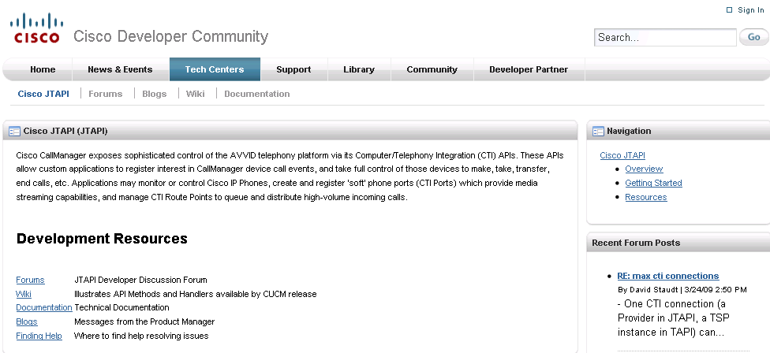
Getting Started
http://developer.cisco.com/web/jtapi/start
JTAPI Developer Guide-provides overview, what’s new and changed, and interface details
  Includes list of CTI supported devices
JavaDocs-illustrates in-depth object, attribute, and connection relationship for all interface methods

Slide 79
Macro API –
Cisco Unified Routing Rules Interface (CURRI)

Slide 80
External Call Control Overview
Administrator assigns an External Call Control Profile (ECCP) to one or more Unified CM translation patterns
When dialed digits match an ECCP pattern, Unified CM issues a Web 2.0 Route Request over the Cisco Unified Routing Rules XML Interface (CURRI)
The Web application evaluates the information and returns call handling instructions as a Decision with Obligation:
Decision - specifies if the call is Allowed or Denied
Obligation - contains specific call routing instructions and treatment
  Route the call normally and optionally modify calling/called party number(s)
  Divert the call to a different destination or to voice mail and optionally modify calling/called party number(s)
  Reject the call and optionally play an announcement

Slide 81
Routing Rules Applications in the Enterprise
Allow/Block Call Lists – permit or deny calls based on Time-of-Day, Day-of-Week, User preferences, Do-Not-Call lists, and company policies
Presence-based routing - combine User availability, location, and preferences to render a uniquely tailored UC experience
  Single Number Reach
  Find me / Follow me / Hide me
Ethical Wall – Allow, Deny, or Redirect calls based on Calling/Called Party. Play custom announcements

Slide 82
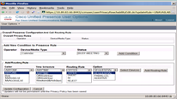

External Call Control Architecture
Unified CM Admin
Unified CM Administrator assigns external call control profile at trigger points (translation patterns)
Cisco UCM
Route Server
HTTP POST
(XACML Request with call info)
A route server hosting call routing policy running web service for Unified CM External Call Control.
HTTP 200 OK (XACML Response with policy decisions & obligation)
D
Unified CM routes the call based on the policy decision and obligation
1. Call
5. Setup

Slide 83
Call Route Request
XACML request sent over HTTP or HTTPS using POST method
Contains the following information about the call:
  Calling number
  Transformed calling number* (see below)
  Called number or dialed digits
  Transformed called number* (see below)
  Type of the triggering point, i.e., translation pattern
* The number that Unified CM’s translation pattern wants to convert the calling and called number to. In our reference dial plans, the transformed value is usually the globalized number of the caller and called party

Slide 84
Example Call Route Request
<?xml version="1.0" encoding="UTF-8"?>
<Request xmlns="urn:oasis:names:tc:xacml:2.0:context:schema:os">
<Subject SubjectCategory="urn:oasis:names:tc:xacml:1.0:subject-category:access-subject">
<Attribute AttributeId="urn:oasis:names:tc:xacml:1.0:subject:role-id” DataType="http://www.w3.org/2001/XMLSchema#string" Issuer="requestor">
<AttributeValue>CISCO:UC:UCMRoute</AttributeValue>
</Attribute>
<Attribute AttributeId="urn:Cisco:uc:1.0:callingnumber” DataType=http://www.w3.org/2001/XMLSchema#string>
<AttributeValue>+19725550101</AttributeValue>
</Attribute>
<Attribute AttributeId="urn:Cisco:uc:1.0:callednumber” DataType="http://www.w3.org/2001/XMLSchema#string">
<AttributeValue>50102</AttributeValue>
</Attribute>
<Attribute AttributeId="urn:Cisco:uc:1.0:transformedcgpn” DataType=http://www.w3.org/2001/XMLSchema#string>
<AttributeValue>+19725550101</AttributeValue>
</Attribute>
<Attribute AttributeId="urn:Cisco:uc:1.0:transformedcdpn” DataType=http://www.w3.org/2001/XMLSchema#string>
<AttributeValue>+19725550102</AttributeValue>
</Attribute>
</Subject>
continued on next slide…

Slide 85
Example Call Route Request - continued
…continued from previous slide
<Resource>
<Attribute AttributeId="urn:oasis:names:tc:xacml:1.0:resource:resource-id” DataType="http://www.w3.org/2001/XMLSchema#anyURI">
<AttributeValue>CISCO:UC:VoiceOrVideoCall</AttributeValue>
</Attribute>
</Resource>
<Action>
<Attribute AttributeId="urn:oasis:names:tc:xacml:1.0:action:action-id” DataType=http://www.w3.org/2001/XMLSchema#anyURI>
<AttributeValue>any</AttributeValue>
</Attribute>
</Action>
<Environment>
<Attribute AttributeId="urn:Cisco:uc:1.0:triggerpointtype DataType=http://www.w3.org/2001/XMLSchema#string>
<AttributeValue>translationpattern</AttributeValue>
</Attribute>
</Environment>
</Request>

Slide 86
Call Route Response
XACML Route Decision and Obligation Details
Route decision values:
Permit: Call is allowed
Deny: Call is denied
Indeterminate: No call routing route is determined.
Follows failure route.
Not Applicable: No route matches the request. Follows failure route.
Obligation overview:
CIXML block contains specific instructions on how the call will be routed and treatment should be applied
CIXML’s obligation must be consistent with route decision. If it is not, Unified CM obeys the route decision, not the obligation

Slide 87
CIXML Obligation Details
Continue – Routes normally to current destination
  greeting identification=[id]: An announcement specified by [id] will be played to the caller before being connected to the called party
  modify callingnumber=[number] callednumber=[number]: Calling and/or called numbers will be substituted with the numbers provided
Divert – Route to diverted destination specified
  destination: [dest]: The [dest] is a routable number or “voicemail”
  reason: [reason]: the only reason supported in 8.0(1) is “chaperone”
  modify callingnumber=[number] callednumber=[number]: Calling and/or called numbers of current hop will be substituted with the numbers provided
  resetCallHistory: The last call hop or all previous call hops will be removed from the call history. Useful when sending call to voicemail.

Slide 88
CIXML Obligation Details
Reject – Call Rejected.
Caller hears (optional announcement followed by fast busy.
  announce announce=[id]: An announcement specified by [id] will be played to the caller when call is rejected
  reason: [reason]: The reason for the call rejection. The reason is logged to the alarm CallAttemptBlockedByRoute

Slide 89
Example Call Route Response
<?xml encoding="UTF-8" version="1.0"?>
<Response>
<Result>
<Decision>Permit</Decision>
<Obligations>
<Obligation FulfillOn="Permit" ObligationId="continue.simple">
<AttributeAssignment AttributeId="Route:continue.simple”
<AttributeValue DataType="http://www.w3.org/2001/XMLSchema#string”
<cixml version="1.0>
<divert>
<destination>
+19725550100
</destination>
</divert>
</cixml>
</AttributeValue>
</AttributeAssignment>
</Obligation>
</Obligations>
</Result>
</Response>

Slide 90
Custom Announcements
Route Server can instruct Unified CM to play a specific announcement to the caller before connecting the caller to the called party and when rejecting a call
Cisco provides the following set of pre-recorded announcements for all the locales supported by Unified CM:
  Your call has been disallowed by corporate route
  You are not authorized to make 900 phone calls
  You are not authorized to make international calls
  You are not authorized to make toll calls
  Calls to directory assistance are not allowed
  This call may be monitored or recorded
  Your call will be completed momentarily
Customized announcements with specific locale can be uploaded to replace the default announcements provided by Cisco

Slide 91
Basic Requirements for Web Application
HTTP 1.1 for persistent connection
Support thread pool for multiple persistent connections
Support HTTP KeepAlive header
Support HTTPS connection with mutual authentication using certificates
Support HTTP HEAD method for KeepAlive from Cisco Unified CM
Support XACML Call Routing request as specified in Cisco Unified Route XML API specification
Support HTTP POST method for XACML Call Routing Request
Respond with XACML Call Routing Response as specified in Cisco Unified Route XML API specification

Slide 92
Performance
Unified CM experiences some degree of performance degradation if it queries route servers for a majority of incoming calls
The performance degradation depends on the following factors:
  Response time from route servers
  Network latency for call routing requests and responses
Slow response or network latency adds delay to the post-dial silence for a call
Preliminary testing shows that when the response time from the route server is below 50ms (RTT), there is a 15% degradation in the maximum call rate when all calls are subject to a Route Request/Response

Slide 93
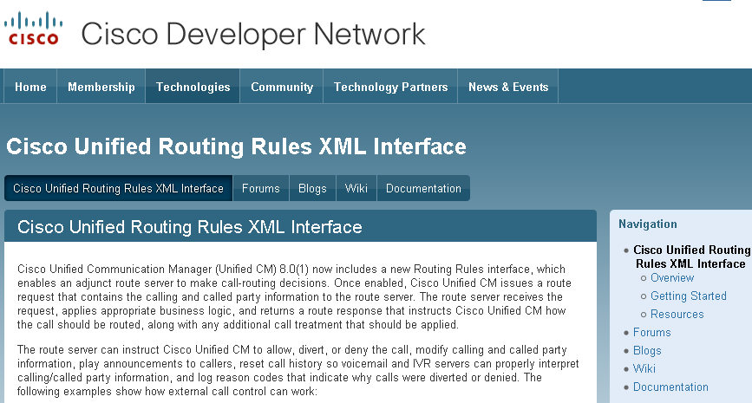
Getting Started
http://developer.cisco.com/web/curri/start
Documentation, NFR software, hardware, devices, tool kits, sample applications, interface specs
Routing Rules API information is found in Chapter 5 of the Cisco Unified Communication Manager XML Developer’s Guide

Slide 94
Macro API -
Cisco WebDialer

Slide 95
What Is WebDialer?
A Unified CM service responsible for processing MakeCall requests on behalf of SOAP and HTTP-based applications
Efficiently uses CTI resources
Limited to MakeCall. Other functions such as hold, transfer, conference, etc., are not supported (use CTI, TAPI, JTAPI)
Classified as a macro-API because the developer is abstracted from many of the details compared to standard CTI (TAPI, JTAPI)

Slide 96
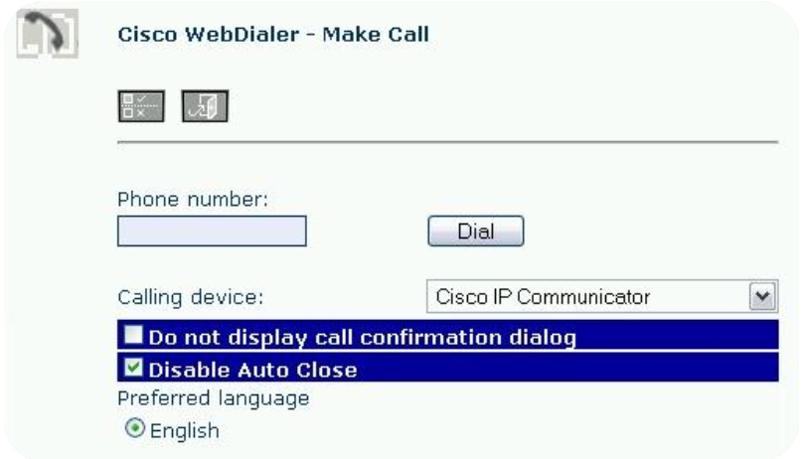
Web-Based Click-to-Dial Applications
Enables click-to-dial for
web-based applications
Uses HTTP WebDialer methods
WebDialer provides the User interface
Supports localization

Slide 97
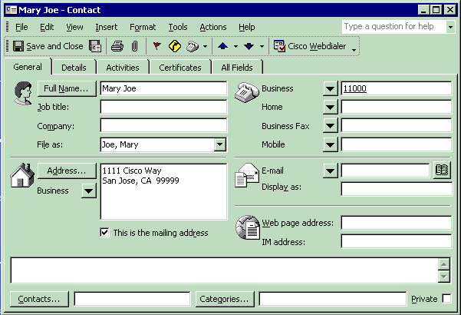
Desktop Client-Based Applications
Enables click-to-dial
for desktop applications
Uses WebDialer
SOAP methods
Developer provides
the User interface
Here is an example
of an outlook plug-in
a partner created

Slide 98
HTTP vs. SOAP-
Which Should You Choose?
HTTP WebDialer applications
  Server based
  Minimal code work
  Uses WebDialer UI-WebDialer controls the User experience
SOAP WebDialer applications
  Server or desktop based
  Developer controls the User experience
  Client application is responsible for capturing User credentials, Unified CM server, preferred device, and preferred line

Slide 99

Architecture
Web Dialer and Redirector Service
Browser
Tomcat
HTTPS
HTTP Interface
Web Dialer and Redirector Servlet
SOAP Service Requester
SOAP over HTTPS
WSDL Doc
Third-Party
App
CTI Manager
UCM
DB
Connect/End Call
Subscriber
Subscriber
User Phone

Slide 100
SOAP WebDialer Methods
5.1 onwards SOAP is over HTTPS (SSL) instead of the earlier HTTP
SOAP over HTTPS Interface
makeCallSoap - issues MakeCall request using User or proxy credentials
endCallSoap - drops outgoing call in progress
getProfileSoap - gets User device Info
getProfileDetailedSoap - gets even more User
device info
isClusterUserSOAP - determines User’s home cluster

Slide 101
HTTP WebDialer Methods
makeCall - issues MakeCall request with
User credentials
makeCallProxy - issues MakeCall request with
proxy credentials
Remaining actions are invoked using the WebDialer UI

Slide 102
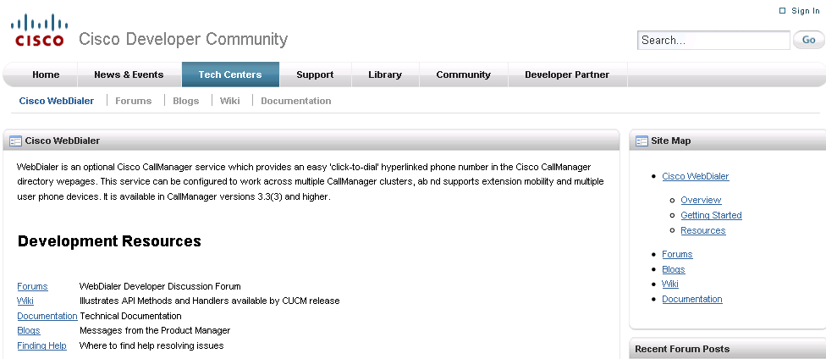
Getting Started
http://developer.cisco.com/web/webdialer/start
Documentation, NFR software, hardware, devices, tool kits, sample applications, interface specs
WebDialer information is found in Chapter 4 of the Cisco Unified Communication Manager XML Developer’s Guide

Slide 103
Serviceability Interfaces

Slide 104
Serviceability Interfaces
A collection of services and tools designed to monitor, diagnose, and address issues specific to Cisco Unified Communications Manager (Unified CM)
Performance Monitoring (PerfMon) - provides real-time event feeds to monitor status and health of Cisco Unified Communication Manager Hardware and Software
Real-time device/CTI feed - provides real-time device registration status including CTI application connections
to the device
Service control - enables remote control of
Unified CM services

Slide 105
Serviceability Interfaces
Log collection - collects and packages Unified CM trace files and logs for troubleshooting and analysis
Call detail record on demand - provides applications with CDR files based on search criteria
SNMP/MIBs - provides management consoles with SNMP/trap events specific to Cisco Unified CM and Cisco MCS hardware

Slide 106

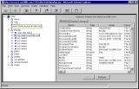
Serviceability Interfaces for Unified CM
Service App
SNMP Agents, MIBs, Traps
Serviceability SOAP API
Cisco-CCM-MIB
Cisco-CDP-MIB
Cisco-SYSLOG-MIB
Standard MIBs
Hardware/Virtualization MIB
Real-time statistics
Performance Counters
CDR on Demand
Service Control
Log Collection
SOAP Operations
SNMP

Slide 107
Serviceability Applications
Intelligent system monitoring - apply business logic and alarm rules to real-time device, application, and hardware metrics to pro-actively monitor Cisco UC
Call accounting - use Cisco’s call detail record-on-demand to pull call data into call accounting systems
Command and control consoles - trap hardware and software thresholds, programmatically enable, disable, or restart processes across the network, report issues
Performance analytics - store and analyze the status and health of Cisco Unified CM as the organization grows and call rates increase to accurately forecast and budget timely software upgrades and hardware replacements

Slide 108











Serviceability Sample Application
Inventory and Capacity Reporting
Email
The Inventory Could Be:
Phones
Gateways, ports
Media resources: conf. bridge, MOH resources, MTP, and so on
Bandwidth across locations/regions
System resources (CPU, mem., and so on) against the planned capacity
SNMP SysLog
1. Track device location
2. Calculate and analyze current capacity
3. Compare with a predefined threshold
4. Decide if the capacity under/over used
5. Send out alerts
PSTN
WAN

Slide 109
Serviceability XML

Slide 110
Serviceability SOAP APIs
Cisco Serviceability SOAP Includes:
Access perfmon counters
Query device information-CTI, CCM, and GWs
Log collection service
CDR on demand service
Control center service
SOAP client can run on different OS
Serviceability
Backend
An Extensible SOAP-Based XML Web Service
SOAP
Client
SOAP

Slide 111
Serviceability XML
SOAP-based-same as administrative XML
Follows standard: http://www.w3.org/TR/SOAP/
Cisco provided WSDL
Follows WSDL standard: http://www.w3.org/TR/wsdl12/

Slide 112
Performance Monitoring (PerfMon)
Allow Clients to Perform the Following Tasks:
Collect perfmon counter data
  Session-based and single-transaction
Retrieve a list of all perfmon objects and counter names installed on a particular host
Retrieve a list of the current instances of a perfmon object
Retrieve textual description of a perfmon counter

Slide 113
Performance Monitoring (PerfMon)
Appliance model PerfMon data uses session-based APIs
Operations supported:
  Perfmon open session
  Perfmon add counter
  Perfmon remove counter
  Perfmon collect session data
  Perfmon close session
A session handle is needed by the client to collect session-based perfmon counter data. The session handle is a unique identifier, used only once

Slide 114
Sample PerfMon List Counter- REQUEST
Returns the list of perfmon objects and counters in a particular host
<?xml version="1.0" encoding="utf-8" ?>
<soap:Envelope xmlns:soap="http://schemas.xmlsoap.org/soap/envelope/"
xmlns:soapenc="http://schemas.xmlsoap.org/soap/encoding/"
xmlns:xsi="http://www.w3.org/2001/XMLSchema-instance"
xmlns:xsd="http://www.w3.org/2001/XMLSchema">
<soap:Body soap:encodingStyle="http://schemas.xmlsoap.org/soap/encoding/">
<q1:PerfmonListCounter xmlns:q1="http://schemas.cisco.com/ast/soap/">
<Host xsi:type="xsd:string">nozomi</Host>
</q1:PerfmonListCounter>
</soap:Body>
</soap:Envelope>
Notes:
Add text

Slide 115
Sample PerfMon List Counter- RESPONSE
<?xml version="1.0" encoding="UTF-8" standalone="no" ?>
<SOAP-ENV:Envelope
SOAP-ENV:encodingStyle="http://schemas.xmlsoap.org/soap/encoding/"
xmlns:SOAP-ENV="http://schemas.xmlsoap.org/soap/envelope/"
xmlns:SOAP-ENC="http://schemas.xmlsoap.org/soap/encoding/">
<SOAP-ENV:Body>
<m:PerfmonListCounterResponse xmlns:m="http://schemas.cisco.com/ast/soap/">
<ArrayOfObjectInfo SOAP-ENC:arrayType="m:ObjectInfoType[]">
<ObjectInfo>
<Name>.NET CLR Memory</Name>
<MultiInstance>true</MultiInstance>
<ArrayOfCounter SOAP-ENC:arrayType="m:CounterType[]">
<Counter>
<Name># Gen 0 Collections</Name>
</Counter>
<Counter>
<Name># Gen 1 Collections</Name>
</Counter>
</ArrayOfCounter>
</ObjectInfo>
</ArrayOfObjectInfo>
</m:PerfmonListCounterResponse>
</SOAP-ENV:Body>
</SOAP-ENV:Envelope>
Notes:
Add text

Slide 116
Sample Perfmon List Instance-REQUEST
Returns the most recent list of instances in a particular host
<?xml version="1.0" encoding="utf-8" ?>
<soap:Envelope xmlns:soap="http://schemas.xmlsoap.org/soap/envelope/"
xmlns:soapenc="http://schemas.xmlsoap.org/soap/encoding/"
xmlns:xsi="http://www.w3.org/2001/XMLSchema-instance"
xmlns:xsd="http://www.w3.org/2001/XMLSchema">
<soap:Body soap:encodingStyle="http://schemas.xmlsoap.org/soap/encoding/">
<q1:PerfmonListInstance xmlns:q1="http://schemas.cisco.com/ast/soap/">
<Host xsi:type="xsd:string">nozomi</Host>
<Object xsi:type="xsd:string">Process</Object>
</q1:PerfmonListInstance>
</soap:Body>
</soap:Envelope>
Notes:
Add text

Slide 117
Sample Perfmon List Instance-RESPONSE
<SOAP-ENV:Envelope SOAP-ENV:encodingStyle="http://schemas.xmlsoap.org/soap/encoding/"
xmlns:SOAP-ENV="http://schemas.xmlsoap.org/soap/envelope/"
xmlns:SOAP-ENC="http://schemas.xmlsoap.org/soap/encoding/">
<SOAP-ENV:Body>
<m:PerfmonListInstanceResponse xmlns:m="http://schemas.cisco.com/ast/soap/">
<ArrayOfInstance SOAP-ENC:arrayType="m:InstanceType[]">
<Instance>
<Name>Idle</Name>
</Instance>
<Instance>
<Name>System</Name>
</Instance>
<Instance>
<Name>SMSS</Name>
</Instance>
<Instance>
<Name>CSRSS</Name>
</Instance>
<Instance>
<Name>WINLOGON</Name>
</Instance>
<Instance>
<Name>SERVICES</Name>
</Instance>
<Instance>
<Name>_Total</Name>
</Instance>
</ArrayOfInstance>
</m:PerfmonListInstanceResponse>
</SOAP-ENV:Body>
</SOAP-ENV:Envelope>
Notes:
Add text

Slide 118
Sample Perfmon Query Counter - REQUEST
Returns the help text of a particular counter
<?xml version="1.0" encoding="utf-8" ?>
<soap:Envelope xmlns:soap="http://schemas.xmlsoap.org/soap/envelope/"
xmlns:soapenc="http://schemas.xmlsoap.org/soap/encoding/"
xmlns:xsi="http://www.w3.org/2001/XMLSchema-instance"
xmlns:xsd="http://www.w3.org/2001/XMLSchema">
<soap:Body soap:encodingStyle="http://schemas.xmlsoap.org/soap/encoding/">
<q1:PerfmonQueryCounterDescription
xmlns:q1="http://schemas.cisco.com/ast/soap/">
<Counter xsi:type="xsd:string">\\nozomi\Server\Files Open
</Counter>
</q1:PerfmonQueryCounterDescription>
</soap:Body>
</soap:Envelope>
Notes:
Add text

Slide 119
Sample Perfmon Query Counter- RESPONSE
<?xml version="1.0" encoding="UTF-8" standalone="no" ?>
<SOAP-ENV:Envelope SOAP-ENV:encodingStyle="http://schemas.xmlsoap.org/soap/encoding/"
xmlns:SOAP-ENV="http://schemas.xmlsoap.org/soap/envelope/"
xmlns:SOAP-ENC="http://schemas.xmlsoap.org/soap/encoding/">
<SOAP-ENV:Body>
<m:PerfmonQueryCounterDescriptionResponse
xmlns:m="http://schemas.cisco.com/ast/soap/">
<HelpText>The number of files currently opened in the server. Indicates current server activity.
</HelpText>
</m:PerfmonQueryCounterDescriptionResponse>
</SOAP-ENV:Body>
</SOAP-ENV:Envelope>
Notes:
Add text

Slide 120
Real-Time Information Port (RisPort)
Query real-time information for devices
  selectCmDevice - used for device-related queries
  E.g., status: registered/unregistered,on/off hook, etc.
Query real-time information for CTI applications
  selectCtiItem - used for CTI manager queries
  E.g., devices open/closed, lines open/closed, number of associations, etc.
getServerInfo - retrieves operating system and application information
Code samples are included in chapter two of the
XML developer guide

Slide 121
Control Center APIs
Supports remote service deployment, undeployment, start, stop, and list operations
soapGetStaticServiceList - returns array of service static specifications, including:
  Service name
  Type (servlet or service)
  Deployable or undeployable service
  Group name
  Dependent services
soapGetServiceStatus - returns status for service(s)
an empty list of services

Slide 122
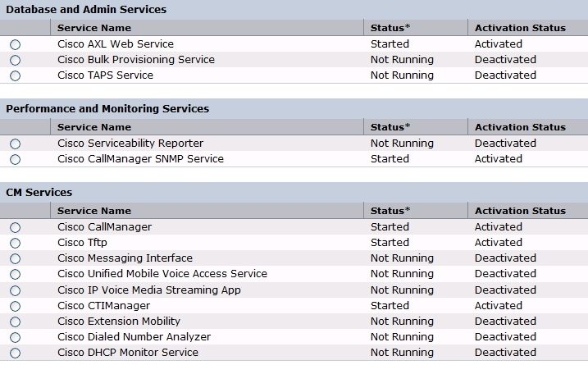
Control Center Services

Slide 123
Control Center APIs
soapDoServiceDeployment - used to deploy or undeploy services with the deployable attribute set to true in the response. Does not allow clients to deploy or undeploy
an empty list of services
soapDoControlServices - used to start or stop a list of services. Empty lists of services can not be used with this method. Also, the following services are core services which can not be stopped:
  A Red Hat DB
  Cisco Tomcat
  Cisco database layer monitor
  Cisco Unified Communications Manager serviceability
  Cisco SOAP-real-time service APIs
  Cisco SOAP-performance monitoring APIs
  Cisco SOAP-log collection APIs

Slide 124
Control Center APIs
getProductInformationList - returns product
information, including:
  Active server version, primary node name, secondary node (if any)
  Array of installed products (including):
    Product name, product version, product description, product ID,
    and short name for the product
  Array of product service specification (including):
    Service name, service type, deployable value, group name,
    product ID, array of dependent services (if any)
For each server in the cluster, clients are expected to
send one request to get all the above information. The system requires clients to send this request only once
during initialization

Slide 125
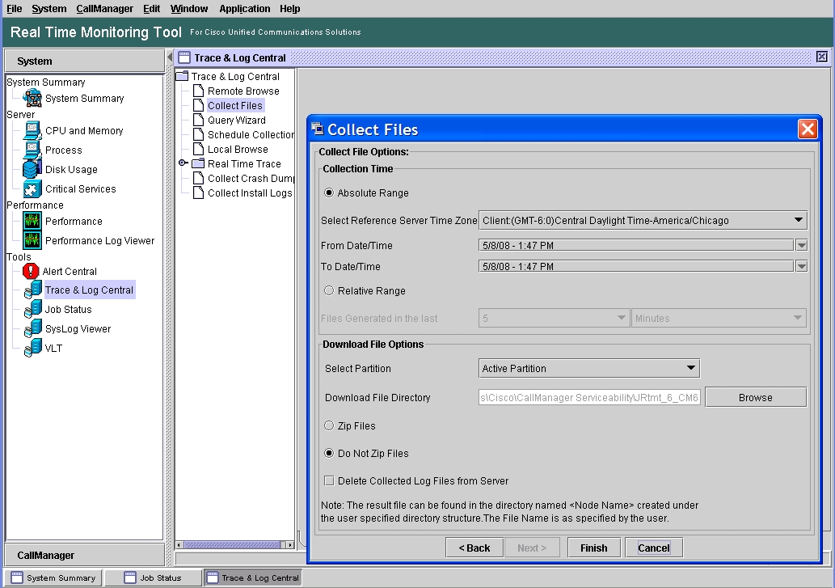
Log Collection Remote Access

Slide 126
Log Collection Port API
listNodeServiceLogs - returns array of NodeServiceLogList, including the node names in the cluster and the lists of service names and system log names
selectLogFiles - takes FileSelectionCriteria object as an input parameter and returns FileSelectionResult. See FileSelectionCriteria on next slide

Slide 127
Log Collection Port API
In FileSelectionCriteria, specify the files that are need by using these parameters:
  LogCollectionService URL- http://hostname/logcollectionservice/services/LogCollectionPort
  Array of service names/system log names for which the files need
  to be collected
  Username-CMAdministrator
  Password-ciscocisco
  Frequency-OnDemand
  File collection time range-possible values are day, week, hour,
  minute, month
  File collection time value-possible values are 1–100
  Time zone-example: Client:(GMT-8:0)Pacific Standard Time
  Time to wait after sending a request-in milliseconds
  Local folder where the files are to copied-Example: d:\soaptest
  Hostname of the server

Slide 128
File Retrieval
File Retrieval API runs under a service called DimeGetFileService
  https://host:8443/logcollectionservice/services/DimeGetFileService
GetOneFile -takes as an input parameter the absolute file name of the file requested from the server
The return value specifies the file name, but the file
name will have an AXIS-specific name. After the file is downloaded, you must replace it with the actual file name that you got from the server

Slide 129
Call Detail Record on Demand Service
SOAP/HTTPS-based interface
Allows third-party billing applications or customers to query the Cisco Unified CM. CDR repository node to retrieve files on demand through the use of two API calls, get_file_list and get_file
CDR records are stored as flat files
CDRs are obtain in a two-step process:
  Application requests CDR file lists based on a specific time interval
  Then, it can request specific CDR files from those lists that are returned via a SFTP session

Slide 130
Call Detail Record on Demand Features
Returns a list of files that match a specified time interval (get_file_list)
Returns a specific file that matches a specified filename (get_file)
Limit of 1300 file names get returned from the get_file_list API
Specified time range cannot span over one hour
Service not available during CDR repository file
maintenance window
CDR files are sent via standard FTP or (s)FTP, which is
User configurable
get_file can return only one file per request
Servlet needs to be activated through service activation page

Slide 131
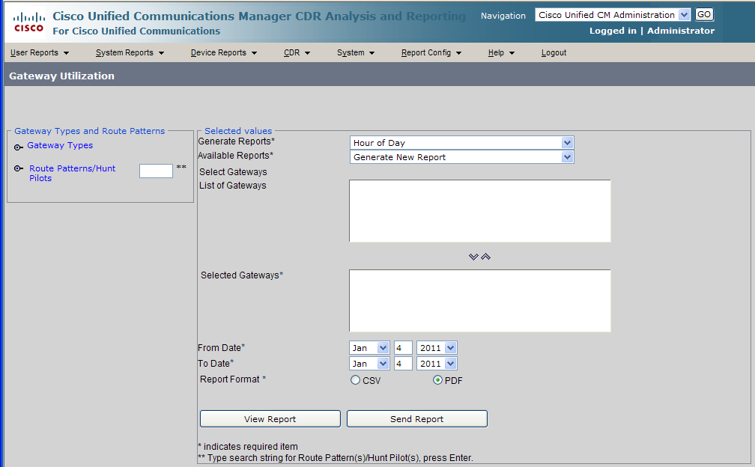
CDR Analysis Tool
Built-in tool to analyze Call Detail Records
Found under Unified CM Serviceability Tools – CDR Analysis and Reporting

Slide 132
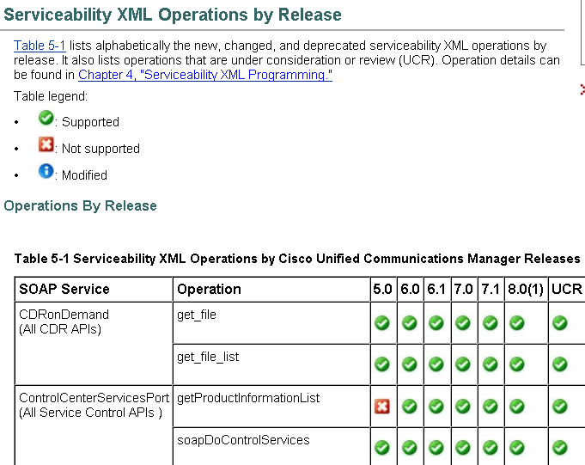
API Planning-Methods by Release
Found in Appendix of XML Developer Guide
Serviceability XML Operations by Release
Table 5-1 below lists alphabetically the new, changed, deprecated Serviceability XML operations by release. It also lists operations that are under consideration or review (UCR). Operation details can be found in “Chapter 4, “Serviceability XML Programming.”
Table Legend
Supported Not supported modified
Operations By Release
Table 5-1 Serviceability XML Operations by Cisco Unified Communications Manager Releases

Slide 133
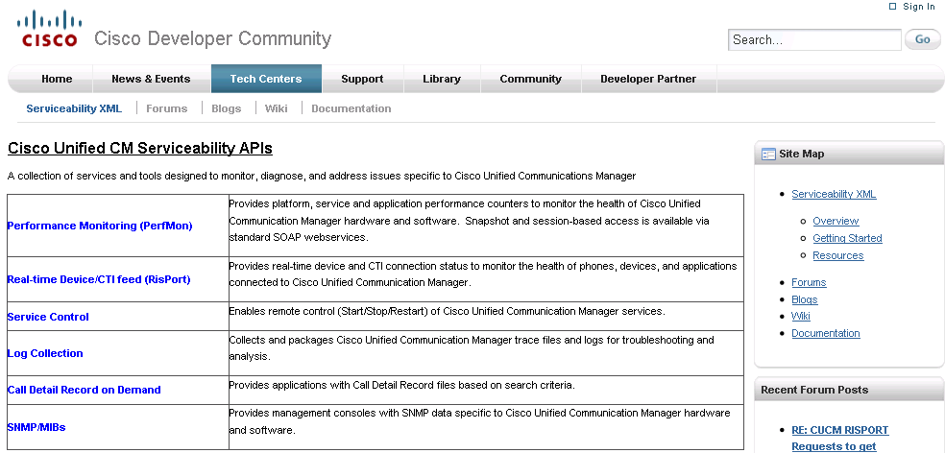
Getting Started
http://developer.cisco.com/web/sxml/start
Documentation, NFR software, hardware, devices, tool kits, sample applications, interface specs
Service XML is found in chapter two of the Cisco Unified Communication Manager XML Developer’s Guide

Slide 134
SNMP and Cisco MIBs

Slide 135
Introduction
SNMP interface allows external applications to query and report various Unified CM entities
Provides information on the connectivity of the Unified Communication Manager to other devices in the network, including syslog information
Support for SNMP v1, v2c, and v3
Start/stop master agent and individual subagents
Trace settings for individual subagents

Slide 136
SNMP Interface
Publisher
SNMP Manager
SNMP Application
SNMP Packets
SNMP/R Master Agent
SNMP/R Master Agent
SNMP/R Master Agent
SNMP/R Master Agent
Unified CM
Subscriber 1
Unified CM
Subscriber 2
Unified CM
Subscriber 3
Unified CM
Subscriber 4

Slide 137
SNMP Architecture
SNMP Application
SNMP Master Agent Listens on Port 161 and Forwards SNMP Packets to Appropriate Agents
SNMP Packets
SNMP Manager Talks to SNMP/R Master Agent on Each Node
SNMP Manager
SNMP Packets
SysLog Agent
SNMP/R Master Agent
CDP Agent
Ccm Agent
Native Agent Adapter
MIB2 Agent
SysAppl Agent
Host Resource Agent
Platform (HP/IBM)
MIB Agents
Per Subscriber

Slide 138
Management Architecture with VMware
SNMP Manager Talks to SNMP/R Master Agent on Each Node
SNMP Application
SNMP Master Agent Listens on Port 161 and Forwards SNMP Packets to Appropriate Agents
SNMP Manager
SNMP Packets
SNMP Packets
SNMP/R Master Agent
SysLog Agent
SysAppl Agent
CDP Agent
Host Resource Agent
Ccm Agent
MIB2 Agent
VMware vCenter
(or other CIM Application)
Vmware ESXi 4.0
CIM Packets
Cisco UCS C-Series
Web Browser or XML App
CIMC
Cisco UCS B-Series
UCS Manager
on UCS 6100

Slide 139
MIBs Supported
Cisco-CCM-MIB, CISCO-CDP-MIB,
Cisco-syslog-MIB
Standard MIBs
  MIB II, SYSAPPL-MIB, HOST RESOURCES-MIB
Vendor MIBs (IBM/HP)
  Vendor MIBs provide hardware information specific to
  the platform
  For a list of hardware specific MIBs, refer to: http://www.cisco.com/en/US/docs/voice_ip_comm/cucm/compat/cmmibcmp.xls

Slide 140
Unified Computing System
VMWare & Hardware MIBs
VMware ESXi SNMP MIB Modules used with Cisco UCS B- and C-series can be downloaded from http://communities.vmware.com/community/developer/forums/managementapi
MIB Quick Reference for Cisco UCS B-series Manager can be found at http://www.cisco.com/en/US/docs/unified_computing/ucs/sw/mib/reference/UCS_MIBRef.html
UCS C-Series Manager MIBs will be available in a future release, check here for the latest http://www.cisco.com/en/US/docs/unified_computing/ucs/overview/guide/UCS_rack_roadmap.html
Local alarming of certain hardware failure cases may only be available through VMWare
With VMware installed, remote monitoring and alarming of hardware using Common Information Model (CIM) is recommended. Refer to the UCS RAID Controller SMI-S Reference Guide for detailed information on this topic.
http://www.cisco.com/en/US/docs/unified_computing/ucs/sw/utilities/raid/reference/guide/ucs_raid_smis_reference.html

Slide 141

CUCM SNMP Interfaces
Unified CM Failed
Phone failed
Phones status update
Gateway failed
Media resource list exhausted
Route list exhausted
Gateway Layer 2 change
Quality report
Malicious call
Syslog generated
Note: Configured via Serviceability Web pages
Interface status, IP address
Applications installed info
RAM, hard disk
Virtual memory usage
Interface management
Service
Application
SNMP Master Agent
SysLog Agent
SYSAPPL-MIB
HOST-RESOURCES-MIB
RFC1213-MIB
IF-MIB
CCM Agent
CISCO-CCM-MIB
CISCO-SYSLOG-MIB
Traps/Informs
Vendor H/W Agent
IBM-SYSTEM-LMSENSOR
IBM-SYSTEM-POWER
IBM-SYSTEM-RAID
IBM-SYSTEM-xxx-MIB
CPQ-xxx-MIB (HP)
CPQHEALTH (HP)
Fan failure
Power supply
Temperature
CUP utilization
Hardware Traps
Syslog Provided by Vendors

Slide 142
CUCM SNMP Interfaces with VMware
Unified CM Failed
Phone failed
Phones status update
Gateway failed
Media resource list exhausted
Route list exhausted
Gateway Layer 2 change
Quality report
Malicious call
Syslog generated
Note: Configured via Serviceability Web pages
Interface status, IP address
Applications installed info
RAM, hard disk
Virtual memory usage
Interface management
Service
Application
SNMP Master Agent
SNMP/R Agent
SYSAPPL-MIB
HOST-RESOURCES-MIB
RFC1213-MIB
IF-MIB
CCM Agent
CISCO-CCM-MIB
CISCO-SYSLOG-MIB
Traps/Informs
Vendor H/W Agent
All syslog, SNMP, etc. provided by server vendors.
For UCS B-series see http://www.cisco.com/en/US/docs/unified_computing/ucs/sw/mib/reference/UCS_MIBRef.html
Hardware Traps

Slide 143
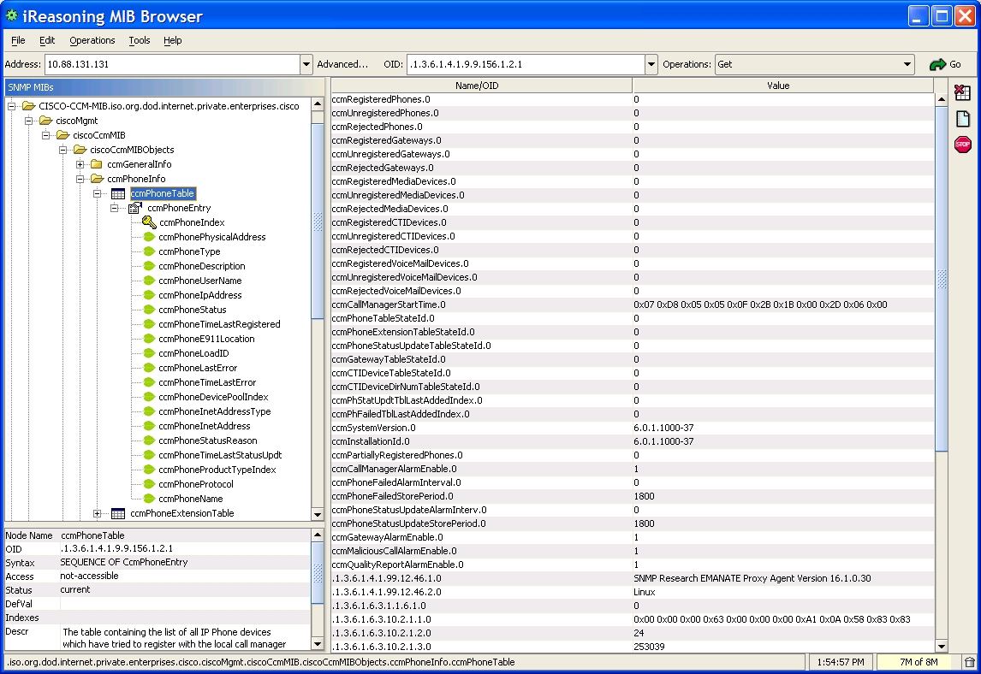
MIB Browser

Slide 144
CISCO-CCM-MIB Overview
Information on devices Unified CM is
communicating with
  For example: phones, gateways, H323 devices, etc.; information includes IP address, DeviceName, MAC, registration status, etc.
SNMP notifications (trap/inform)
  For example: ccmMaliciousCall, ccmGatewayFailed, ccmRouteListExhausted, etc.
Scalar objects
  ccmRegisteredPhones - returns number of phones that are registered and actively communicating with the local Unified CM
  ccmRejectedPhones - returns number of phones whose registration requests were rejected by the local Unified CM

Slide 145
SNMP-CISCO-CCM-MIB (Phone)
ccmRegisteredGateways - number of gateways that are registered and actively communicating with the local Unified CM
ccmUnified CMStartTime - last time the local Unified CM service started. This is available only when the local Unified CM is running

Slide 146
SNMP-CISCO-CCM-MIB (Phone)
Phone tables/notifications.
  ccmPhoneTable - contains complete list of phones.
  ccmPhoneExtnTable - contains extension numbers for the phones in ccmPhoneTable
  ccmPhoneStatusUpdateTable - contains list of phones with recent status changes. (configurable based on time)
  ccmPhoneStatusUpdate - phone status updates
There are more phone related information in
CISCO-CCM-MIB. For complete information go to http://www.cisco.com/go/mibs

Slide 147
SNMP-CISCO-CCM-MIB (Phone)
snmpbulkwalk -c public -v2c 10.77.31.30 1.3.6.1.4.1.9.9.156.1.2
SNMPv2-SMI::enterprises.9.9.156.1.2.1.1.2.36 = Hex-STRING: 00 00 11 11 00 24
SNMPv2-SMI::enterprises.9.9.156.1.2.1.1.2.51 = Hex-STRING: 00 00 11 11 00 07
SNMPv2-SMI::enterprises.9.9.156.1.2.1.1.2.52 = Hex-STRING: 00 00 11 11 00 1F
SNMPv2-SMI::enterprises.9.9.156.1.2.1.1.2.53 = Hex-STRING: 00 00 11 11 00 1D
SNMPv2-SMI::enterprises.9.9.156.1.2.1.1.4.36 = STRING: "Auto 1035"
SNMPv2-SMI::enterprises.9.9.156.1.2.1.1.4.51 = STRING: "Auto 1006"
SNMPv2-SMI::enterprises.9.9.156.1.2.1.1.4.52 = STRING: "Auto 1030"
SNMPv2-SMI::enterprises.9.9.156.1.2.1.1.4.53 = STRING: "Auto 1028"
SNMPv2-SMI::enterprises.9.9.156.1.2.1.1.5.36 = ""
SNMPv2-SMI::enterprises.9.9.156.1.2.1.1.5.51 = ""
SNMPv2-SMI::enterprises.9.9.156.1.2.1.1.5.52 = ""
SNMPv2-SMI::enterprises.9.9.156.1.2.1.1.5.53 = ""
SNMPv2-SMI::enterprises.9.9.156.1.2.1.1.6.36 = IpAddress: 10.77.31.13
SNMPv2-SMI::enterprises.9.9.156.1.2.1.1.6.51 = IpAddress: 10.77.31.13
SNMPv2-SMI::enterprises.9.9.156.1.2.1.1.6.52 = IpAddress: 10.77.31.13
SNMPv2-SMI::enterprises.9.9.156.1.2.1.1.6.53 = IpAddress: 10.77.31.13
SNMPv2-SMI::enterprises.9.9.156.1.2.1.1.8.36 = Hex-STRING: 07 D8 03 1B 0E 0E 1D 00 2B 05 1E
SNMPv2-SMI::enterprises.9.9.156.1.2.1.1.8.51 = Hex-STRING: 07 D8 03 1B 0E 0E 13 00 2B 05 1E
SNMPv2-SMI::enterprises.9.9.156.1.2.1.1.8.52 = Hex-STRING: 07 D8 03 1B 0E 0E 13 00 2B 05 1E
SNMPv2-SMI::enterprises.9.9.156.1.2.1.1.8.53 = Hex-STRING: 07 D8 03 1B 0E 0E 13 00 2B 05 1E
SNMPv2-SMI::enterprises.9.9.156.1.2.1.1.10.36 = STRING: "P00303010102"
SNMPv2-SMI::enterprises.9.9.156.1.2.1.1.10.51 = STRING: "P00303010102"
SNMPv2-SMI::enterprises.9.9.156.1.2.1.1.10.52 = STRING: "P00303010102"
SNMPv2-SMI::enterprises.9.9.156.1.2.1.1.10.53 = STRING: "P00303010102”

Slide 148
SNMP-CISCO SYSLOG MIB
Any syslog message can be sent out as trap
Includes ability to monitor events generated by
multiple hardware vendors (IBM, HP, Dell)
Remote configuration across distributed
SNMP topologies
Ability to generate traps based on severity and
string matches
Configured via snmp set
  E.g., severity of syslog message to trigger trap

Slide 149
CISCO-SYSLOG-MIB Subagent Architecture
A
L
A
R
M
I
N
T
E
R
F
A
C
E
System/Kernel
Generates
Syslogs
S
E
R
V
I
C
E
A
P
P
L
I
C
A
T
I
O
N
Services
CCM
Local
Syslog
Daemon
Cisco
Syslog
MIB
SubAgent
SNMP/R
Master
Agent
CTI
Notification
CEF
Syslogs
Any
Application
Generating
Syslog

Slide 150
SNMP-CISCO SYSLOG MIB
snmpbulkwalk -c public -v2c 10.77.31.30 1.3.6.1.4.1.9.9.41
SNMPv2-SMI::enterprises.9.9.41.1.1.1.0 = Counter32: 10042
SNMPv2-SMI::enterprises.9.9.41.1.1.2.0 = INTEGER: 1
SNMPv2-SMI::enterprises.9.9.41.1.1.3.0 = INTEGER: 5
SNMPv2-SMI::enterprises.9.9.41.1.1.4.0 = Counter32: 12086
SNMPv2-SMI::enterprises.9.9.41.1.1.5.0 = Counter32: 0

Slide 151
SNMP-CISCO CDP MIB
Advertises Unified CM to other Cisco devices and shows interfaces. Helps obtain protocol address of neighboring devices
CDP subagent integrates with the CDP daemon through the CDP Interface library
The tables implemented are:
  cdpInterfaceTable - table containing the status of CDP on the device’s interfaces
  cdpGlobal - table containing information that is advertised to its neighbors

Slide 152
SNMP-CISCO CDP MIB
snmpbulkwalk -c public -v2c 10.77.31.30 1.3.6.1.4.1.9.9.23
SNMPv2-SMI::enterprises.9.9.23.1.1.1.1.2.4 = INTEGER: 1
SNMPv2-SMI::enterprises.9.9.23.1.1.1.1.3.4 = INTEGER: 60
SNMPv2-SMI::enterprises.9.9.23.1.1.1.1.4.4 = INTEGER: 0
SNMPv2-SMI::enterprises.9.9.23.1.1.1.1.5.4 = INTEGER: 0
SNMPv2-SMI::enterprises.9.9.23.1.3.1.0 = INTEGER: 1
SNMPv2-SMI::enterprises.9.9.23.1.3.2.0 = INTEGER: 60
SNMPv2-SMI::enterprises.9.9.23.1.3.3.0 = INTEGER: 180
SNMPv2-SMI::enterprises.9.9.23.1.3.4.0 = STRING: "CISCART30.localdomain"
SNMPv2-SMI::enterprises.9.9.23.1.3.5.0 = Timeticks: (0) 0:00:00.00
SNMPv2-SMI::enterprises.9.9.23.1.3.6.0 = STRING: "2"
SNMPv2-SMI::enterprises.9.9.23.1.3.7.0 = INTEGER: 3

Slide 153
SNMP-SYSAPP MIB
Provides information about the applications installed and running on Unified CM
The tables implemented are :
  sysApplInstallPkgTable - table listing the software application packages installed on a host computer
  sysApplInstallElmtTable - details the individual application package elements (files and executables) which comprise the applications defined in the sysApplInstallPkg table
  sysApplRunTable - table describes the applications which
  are executing on the host
  sysApplPastRunTable - history of the applications that have previously run on the host computer

Slide 154
SNMP-CISCO SYSAPP MIB
snmpbulkwalk -c public -v2c 10.77.31.30 1.3.6.1.2.1.54.1
SNMPv2-SMI::mib-2.54.1.1.1.1.2.1 = STRING: "Cisco Systems, Inc.“
SNMPv2-SMI::mib-2.54.1.1.1.1.3.1 = STRING: "Cisco Unified CM“
SNMPv2-SMI::mib-2.54.1.1.1.1.4.1 = STRING: "5.1.2.3000-2“
SNMPv2-SMI::mib-2.54.1.1.1.1.5.1 = STRING: "n/a“
SNMPv2-SMI::mib-2.54.1.1.1.1.6.1 = Hex-STRING: 07 D8 02 1D 06 0D 1C 00 2B 05 1E
SNMPv2-SMI::mib-2.54.1.1.1.1.7.1 = STRING: "/ccmadmin/showHome.do“
SNMPv2-SMI::mib-2.54.1.1.2.1.2.1.1 = STRING: "ccm“
SNMPv2-SMI::mib-2.54.1.1.2.1.3.1.1 = INTEGER: 5
SNMPv2-SMI::mib-2.54.1.1.2.1.4.1.1 = Hex-STRING: 07 D8 02 1D 06 0D 1C 00
SNMPv2-SMI::mib-2.54.1.1.2.1.5.1.1 = STRING: "/usr/local/cm/bin"

Slide 155
SNMP Notifications
Support trap (v1/v2c/v3)
Added support for Inform (v2c/v3)
Supports multiple trap/inform destinations
No default community string configured. Needs to
be configured from the Unified CM serviceability
web interface

Slide 156
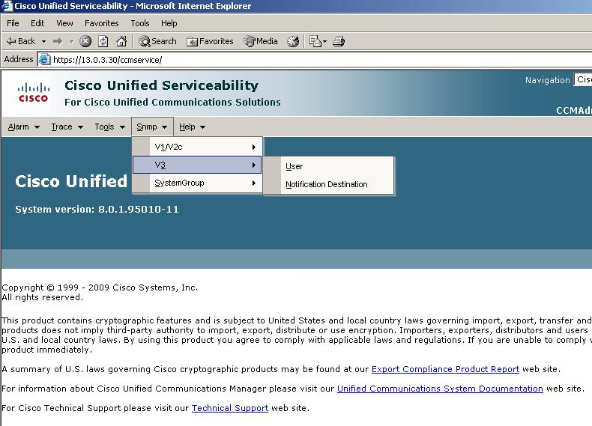
SNMP-Configuration

Slide 157
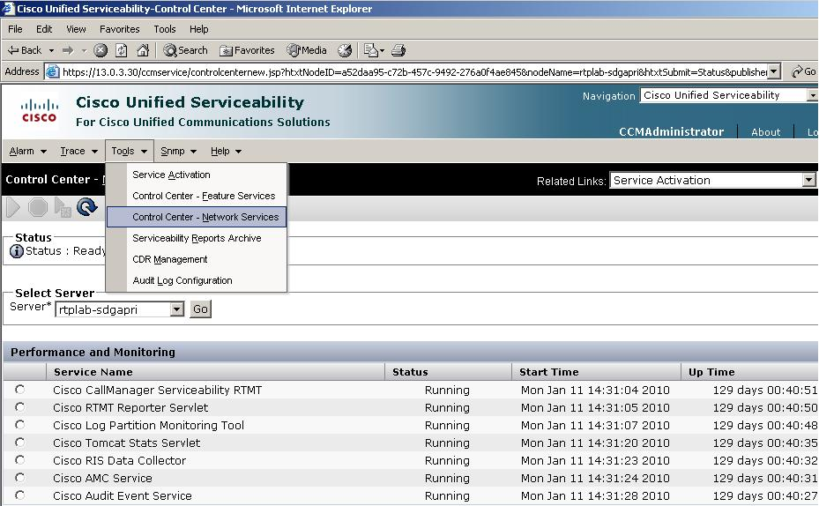
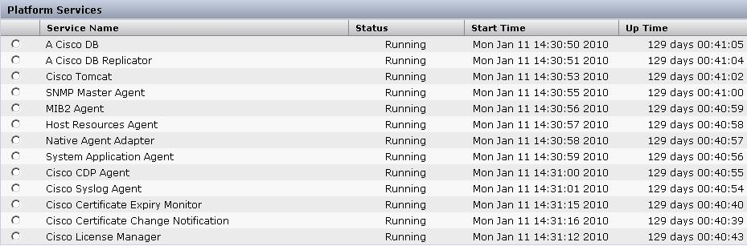
SNMP-Starting Master Agent
SNMP Services can be started/stopped from Control Center page and also programmatically via SOAP.

Slide 158
SNMP Configuration
The ccmAgt (Cisco Unified CM SNMP service)
by default is not activated
All other agents are by default are running on a
Unified CM box
Trace levels for Cisco Unified CM SNMP service
can be configured from the Unified CM serviceability web interface
For syslog, cdp agent, the configuration can be changed from CLI
  E.g., set trace detailed cdpmib

Slide 159
Troubleshooting Tips
Verify the community string and snmp User credentials.
By default, no community string or User is configured on
the system
Use the available scalar variables (1.3.6.1.4.1.9.9.156.1.5) to determine the table size before accessing the table
Reduce the number of variables queried in a single request
Increase the response timeout
Reduce the number of retries
Use getbulk API when it is known that the table is not empty, and also know the number of records

Slide 160
Getting Started
http://developer.cisco.com/web/sxml/start
SNMP specific documentation section: Unified CM traps, MIB definitions,
interface specs

Slide 161
Developer Announcements,
Programs, & Support Options

Slide 162
Stay Informed
Interface enhancements and changes will be announced using the Cisco developer network blog RSS feed feature
Subscribe by navigating to the appropriate tech center
Click on blogs
Click on Subscribe to this blog link

Slide 163
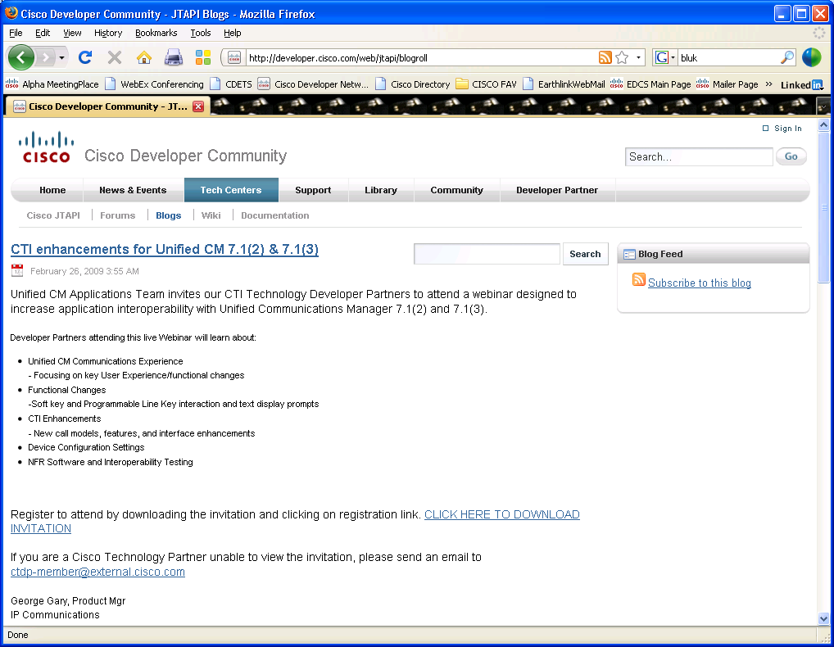

Slide 164
Cisco Developer Community
Announcement blogs
Discussion forums
Quick reference guides and how to white papers
Documentation
  Interface specs, JavaDocs, training materials
Sample applications
Support
Where do I go to get all this information?
  Cisco Developer Community http://developer.cisco.com

Slide 165
Cisco Developer Network Program (CDN)
Cisco technology developer program-members
who enhance and unite the comprehensive Cisco technology portfolio with products that feature
verified interoperability
  http://developer.cisco.com/web/partner
Developer services-developer support (TAC) covering Cisco’s Unified CM interfaces
  http://developer.cisco.com/web/devservices

Slide 166
Support Options
Self-help
  Access community tools, resources, discussion forums,
  and subject matter experts to quickly find an answer to
  your question/issue
Developer services program
  Get expert technical help for your application development
  and integration

Slide 167
Q & A

